Slide 1
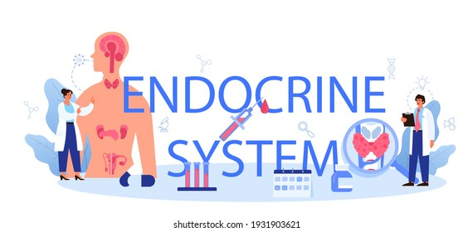


Mr. Yates
Title
Mr Yates 2022
Year 12 Human Biology

Slide 3
Students will be able to:

Slide 4
Hormones help control the body
The body is composed of trillions of cells that are organised into tissues, organs and systems. All these structures must work together in a coordinated way. This coordination is achieved through the activities of the nervous system and the endocrine system.
The nervous system exerts control by the transmission of nerve impulses to and from the various tissues.
The endocrine system influences the activity of cells by the release of chemical messengers known as hormones.
Notes:
Teacher Cue – refer to the vocabulary box as you read through and “unpack” the definition provided. Use hand gestures to emphasise the ”2 or more”, “mixed” and “separated” parts of the definition.
Have students complete CFU 1 as a pair-share, then record these definitions & examples as notes (with diagrams) if desired.
CFU 2 – pair-share, then whiteboards for answers – call on non-volunteers.

Slide 5
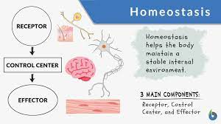
Hormones help control the body
Much of the work of the endocrine system is concerned with keeping the environment inside the body fairly constant.
Maintaining a stable internal environment is known as homeostasis. In this chapter, we will discuss how the endocrine system maintains homeostasis and controls cellular activities through chemical messengers.

Slide 6
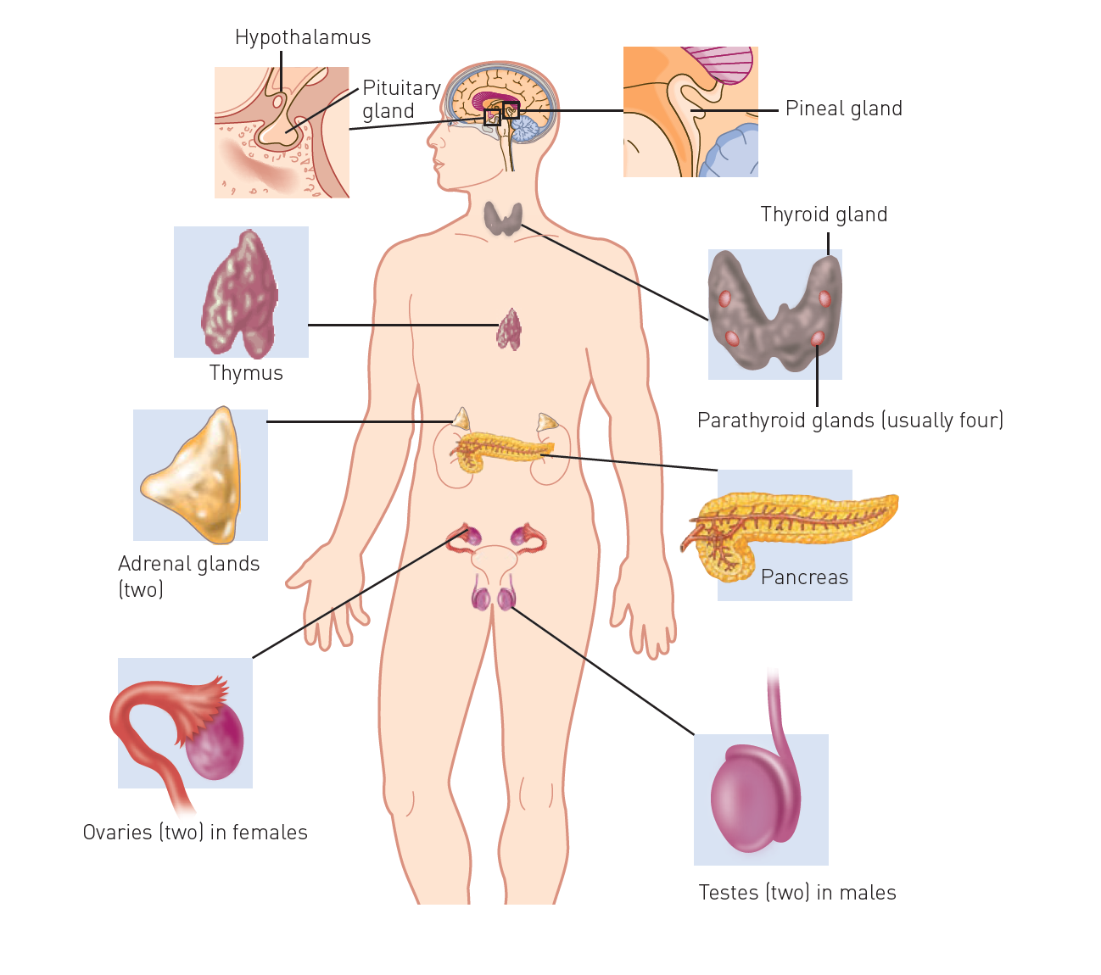
The Endocrine System
The endocrine system is made up of endocrine glands, which secrete hormones.
Notes:
CFU – read through the slide, have students look closely at the diagram, then allow think time, before asking them to explain it to their partner using the key terms pure substance and mixture. Call on non-volunteers and provide feedback, encouraging detailed responses in full sentence form.

Slide 7
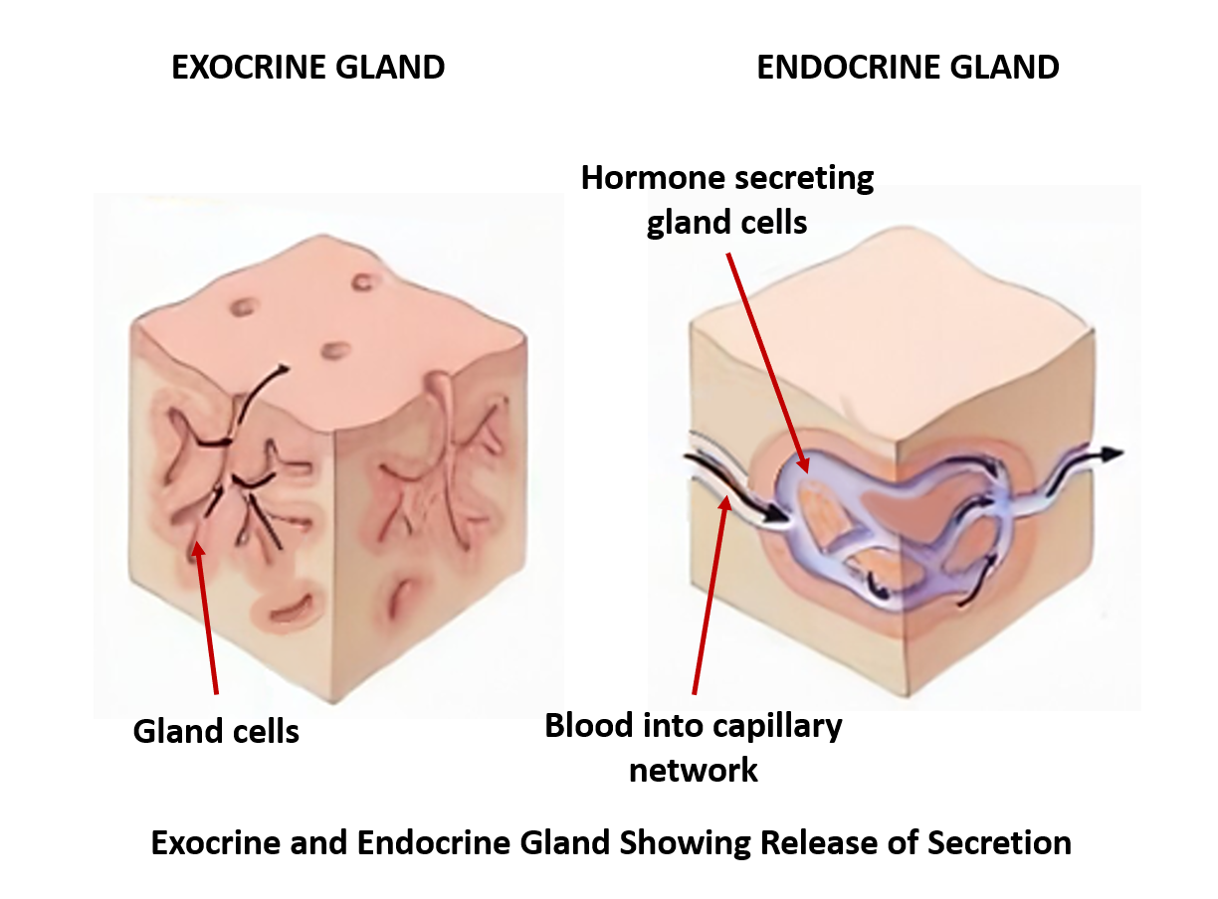
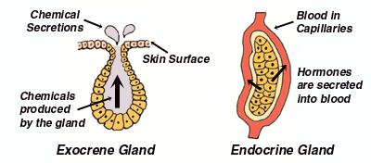
The Endocrine System
There are two types of glands in the body.
Exocrine glands secrete into a duct that carries the secretion to the body surface or to one of the body cavities Sweat glands, mucous glands, salivary glands and the glands of the alimentary canal are examples of exocrine glands.
Endocrine glands secrete hormones into the extracellular fluid that surrounds the cells that make up the gland. The secretion then usually passes into the capillaries to be transported by the blood. Endocrine glands are sometimes called ductless glands.
Notes:
CFU – read through the slide, have students look closely at the diagram, then allow think time, before asking them to explain it to their partner using the key terms pure substance and mixture. Call on non-volunteers and provide feedback, encouraging detailed responses in full sentence form.

Slide 8
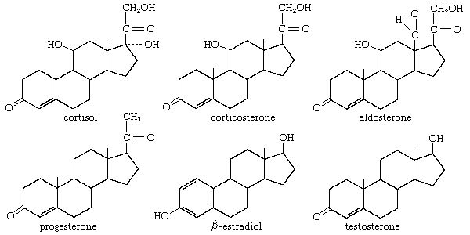
Hormones
Hormones are chemicals secreted by endocrine glands, that are transported throughout the body in the blood. They change the functioning of cells by changing the type, activities or quantities of proteins produced. They are not enzymes; however, in many cases, hormones exert their influence by changing the activity of enzymes or their concentration.
Hormones may:
Activate certain genes in the nucleus so that a particular enzyme or structural protein is produced.
Change the shape or structure of an enzyme so that it is turned “on” or “off”.
Change the rate of production of an enzyme or structural protein by changing the rate of transcription or translation during protein production.
Hormones are only able to influence cells that have the correct receptor for the hormone.

Slide 9
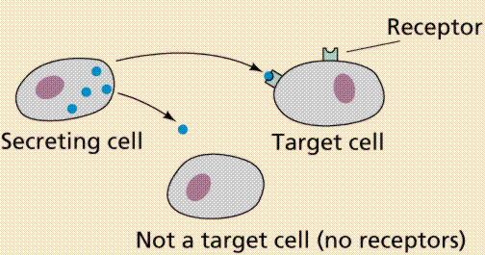
Hormones
Therefore, a hormone may affect:
All the cells of the body.
Only particular groups of cells, target cells.
Only particular organs, target organs.
Hormones may be steroids, proteins or amines.

Slide 10
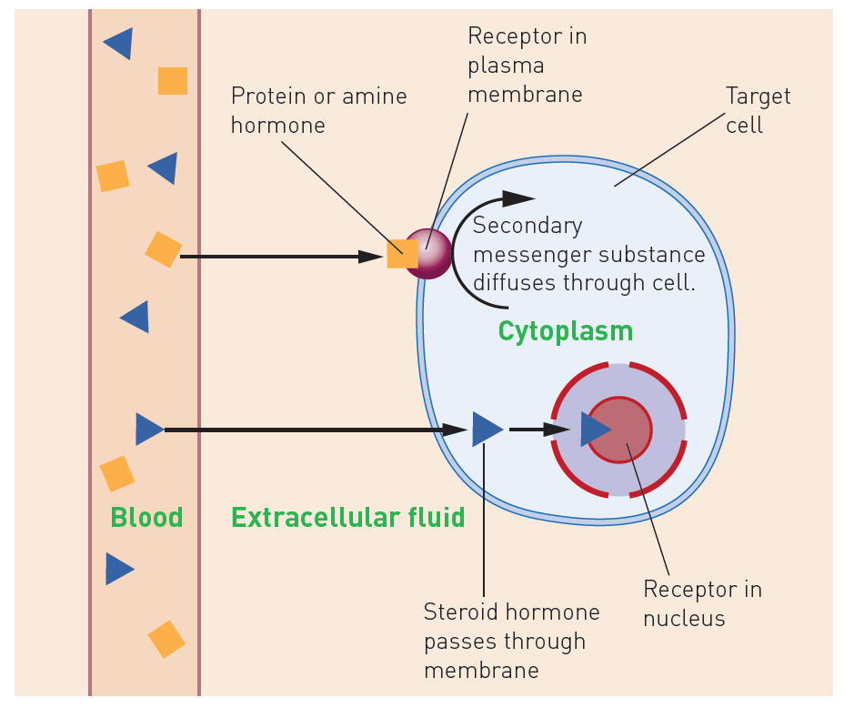
Steroid Hormones
Steroid hormones, such as oestrogen, progesterone, cortisol and aldosterone, are lipid-soluble, meaning they do not dissolve in water.
Once they are released into the blood, the hormones bind to transport proteins, enabling them to travel in the bloodstream. When they reach the target cells, the steroid hormones separate from the transport proteins and diffuse across the cell membrane.

Slide 11
Steroid Hormones
Inside the cell they work by combining with a receptor protein in the cytoplasm or nucleus. The hormone-receptor complex activates the genes controlling the formation of particular proteins.
It does this by binding to the promoter section of a certain gene, stimulating (or inhibiting) transcription and, therefore, protein synthesis. Steroid hormones are slow to have an effect, but the effect is long lasting.

Slide 12
Protein and Amine Hormones
Protein and amine hormones are water-soluble.
Because they are not lipid soluble, they are unable to diffuse across the cell membrane. Instead, they work by attaching to receptor proteins in the membrane of the target cell.
The combination of the hormone with the receptor causes a secondary messenger substance to diffuse through the cell and activate particular enzymes.
For example, the hormone insulin binds to a receptor protein, and this leads to an increase in glucose absorption by the cell. Protein and amine hormones tend to be quick to cause a response; however, the effect is short lasting.

Slide 13
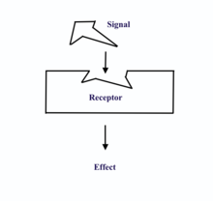
Hormone Receptors
Receptor proteins are specific Each type of receptor will bind with only one specific molecule.
The lock and key analogy can be used to describe this interaction. The lock, the receptor protein, will only work with the correct key, the binding molecule.

Slide 14
Hormone Receptors
There are a limited number of receptor proteins in the membrane of each cell. When each receptor is bound to a molecule, there can be no further increase in the rate of the cell's activity.
For example, when each insulin receptor in the cell membrane is bound to insulin, the cell's rate of glucose uptake cannot increase any further even if the amount of insulin increases.
This means that saturation can occur; once all the receptor molecules are occupied by hormone molecules, the addition of more hormones does not produce any greater effect.
Different cells have different types and numbers of receptor proteins. This is why there is variation in the sensitivities of cells to hormones and other substances.

Slide 15
Enzyme amplification
One hormone molecule does not cause the manufacture or activation of just molecule of an enzyme - it activates thousands of molecules. This is achieved through a process called enzyme amplification.
The hormone triggers a cascading effect in which the number of reacting molecules involved is increased hundreds thousands of times for each step along the metabolic pathway.
One hormone molecule could trigger the production of more than a billion enzyme molecules. Thus, a very small stimulus can produce a very large effect.

Slide 16
Hormone clearance
Once a hormone has produced the required effect, it must be turned off. This is done by breaking down the hormone molecules.
Some hormones are broken down in the target cells, but most are broken down in the liver and the kidneys. The degraded hormones are then excreted in either the bile or the urine.

Slide 17
Control of hormone secretions
To maintain homeostasis, the amount of hormone produced by an endocrine gland must be very closely regulated. Any over secretion or under secretion of a hormone will cause the body to function abnormally.
Hormonal secretions are generally regulated by negative feedback systems whereby the response produced by the secretion of the hormone is the opposite of the stimulus that caused the secretion. Negative feedback systems will be covered in more detail later.

Slide 18
Key concept
The endocrine system is made up of the endocrine glands, which secrete steroid, protein or amine hormones that affect the functioning of the cell.

